Slide 1
Fully Autonomous Smart Traffic Management System
using Artificial Intelligence CNN and LSTM
Christofel Rio Goenawan - 20233970
Fundamental of Vehicular Electric Systems
Final Project Presentation
April 26th 2023

Slide 2
ㅊ
Contents
What is the Problems ?
What is the Solutions ?
How to Make the Solutions ?
How Good is the Solution ?

Slide 3
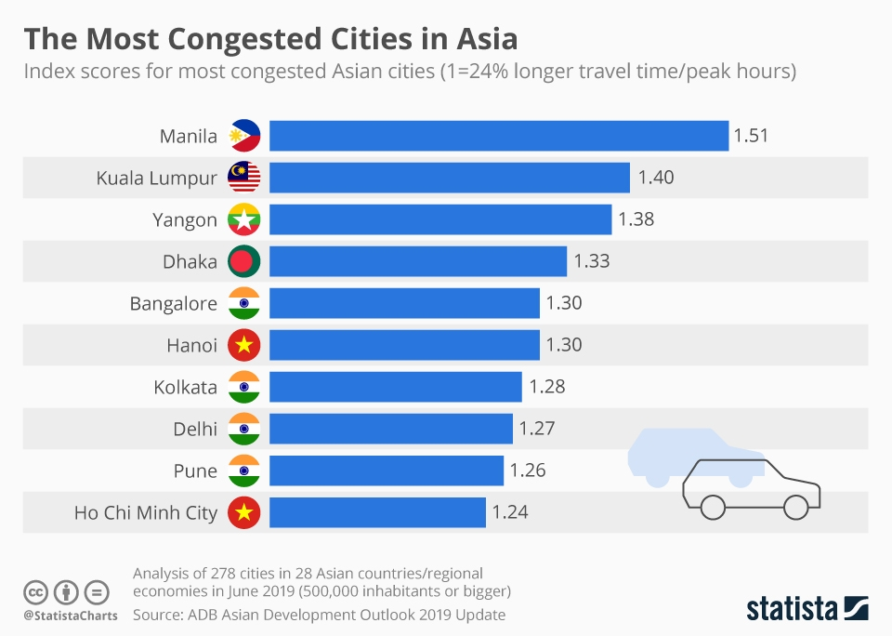
What is the Problems ?
Based on Data by Asia Development Bank in South East Asia ( SEA ) Traffic Congestion Time is Most Severe with Trip Time Rate around 5 K / H That is 5 Times More Severe than Trip Time in America and Europe ( around 22 KM / H )
Based on Data by United Nations Traffic Congestion Time in South East Asia Cost 3,5 % Gross Domestic Products and Make Loss Around $ 4,600,000,000 per Year
We Can Solved Traffic Congestion Problems in South East Asia to Decrease Trip Time Rate and Increase Country Productivity and Increase Safety in Traffic Accidents

Slide 4

What is the Solutions ?
To Solve Traffic Congestion Problems in South East Asia We Can Use Smart Traffic Management Systems to Understand Traffics System in South East Asia and Predict Traffic Congestion in South East Asia by Using Artificial Intelligence

Slide 5
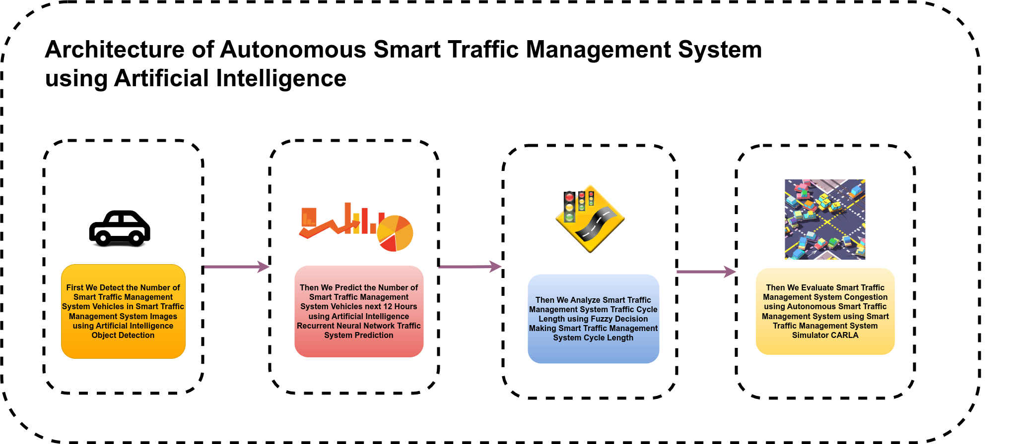
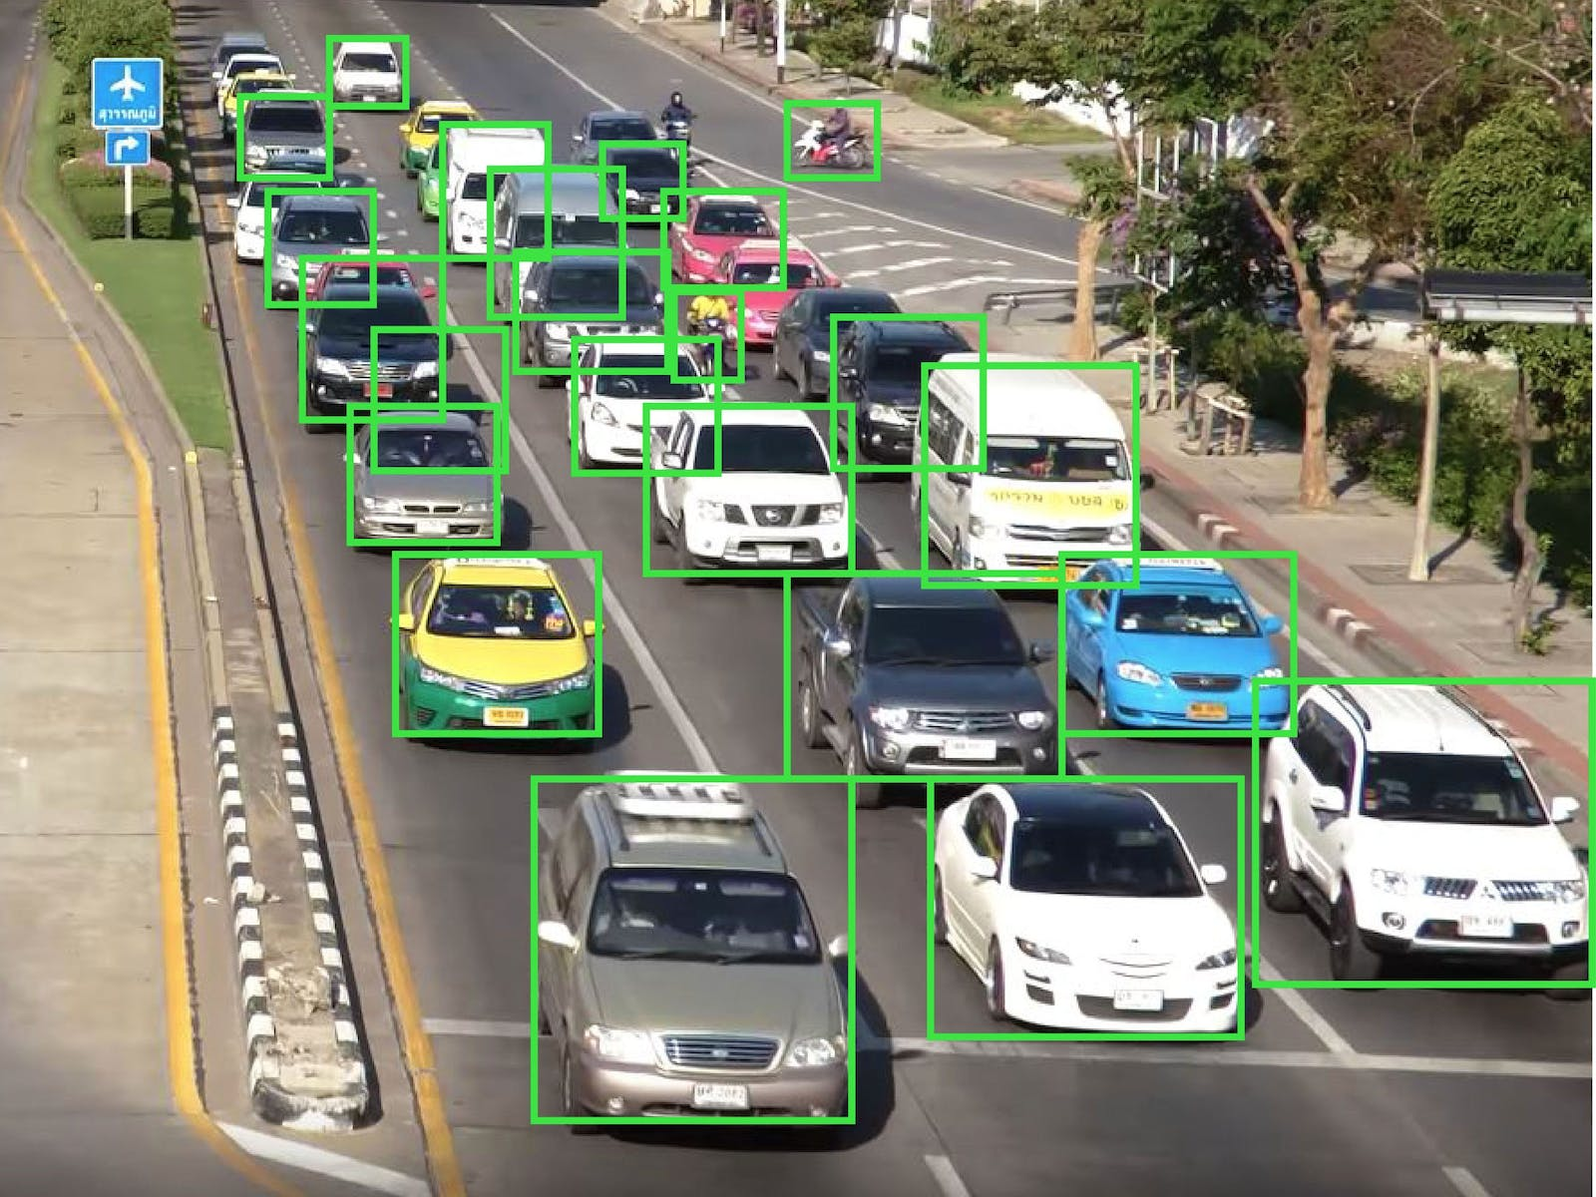
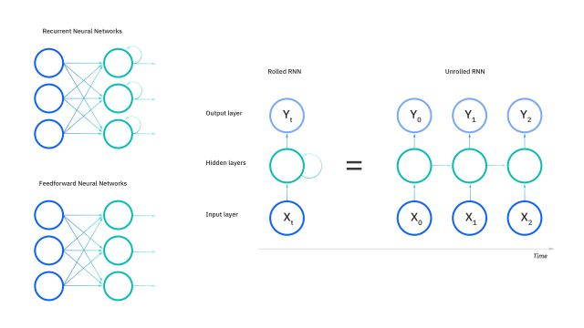
How to Make the Solutions ?

Slide 6
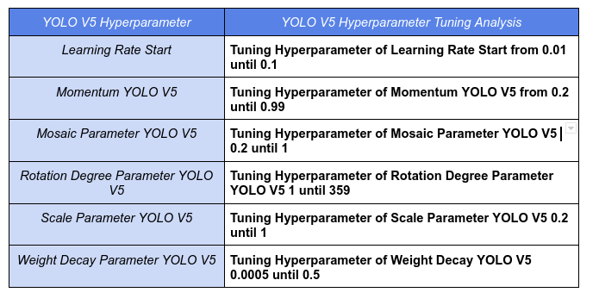
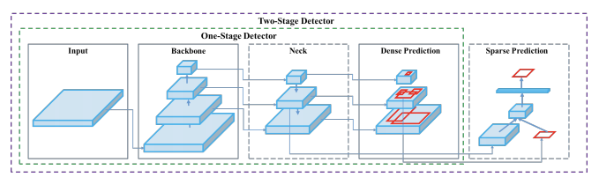
How to Make the Solutions ?
We use YOLO V5 Convolutional Neural Network for Predicting Smart Traffic Management Vehicles in Smart Traffic Management Images
Then We Tuning Hyperparameter of YOLO V5 Convolutional Neural Network to Detect Smart Traffic Management Vehicles in Smart Traffic Management Images

Slide 7
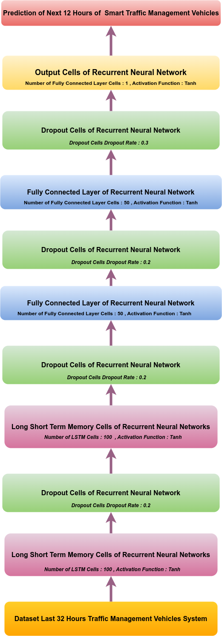
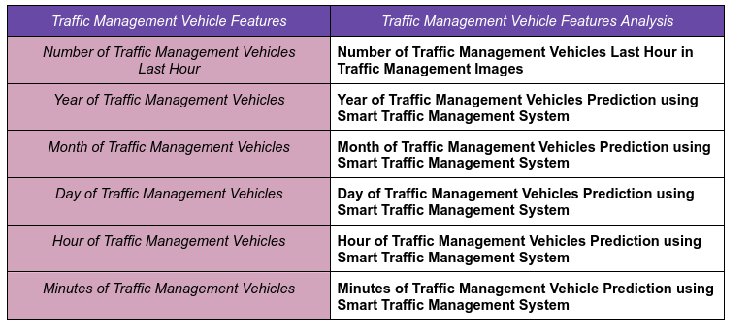
How to Make the Solutions ?
Features of Traffic Management System Vehicles for Predicting Traffic Management System Vehicles next 12 Hours can be seen as below.
We Use Recurrent Neural Network Long Short Term Memory to Predict Traffic Vehicle Management System next 12 Hours.

Slide 8
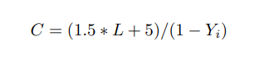
How to Make the Solutions ?
Smart Traffic Management System Can Be Shown by Formula as below
With C is the Length of Smart Traffic Management Red Green Light Cycle , L is Sum of Change Time of Red Green Light Cycle , and Y is the Number of Car and Motorcycle compare to Number of Car and Motorcycle should be per Hour

Slide 9
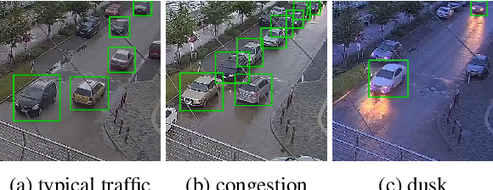

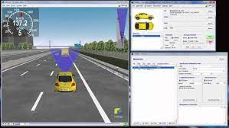
How To Measure the Solutions ?
Writer will Train Artificial Intelligence to Understand what is Car, what is Motorcycle using KITTI Traffic Congestion Dataset
Writer will Make Simulation of Smart Traffic System Management using Artificial Intelligence to know What is Car , what is Motorcycle using IPG Car Maker Simulations

Slide 10
How To Measure the Solutions ?
One of the Important Thing in Traffic Congestion is Traffic Congestion Flow Rate that is How Many Cars and Motorcycles runs through Traffic Congestion per Time.
Writer Will Compare Traffic Congestion Flow Rate and Trip Travel Time of Smart Traffic Management Systems using Artificial Intelligence to Know What is Car What is Motorcycle , etc and Traffic Management System in South East Asia

Slide 11
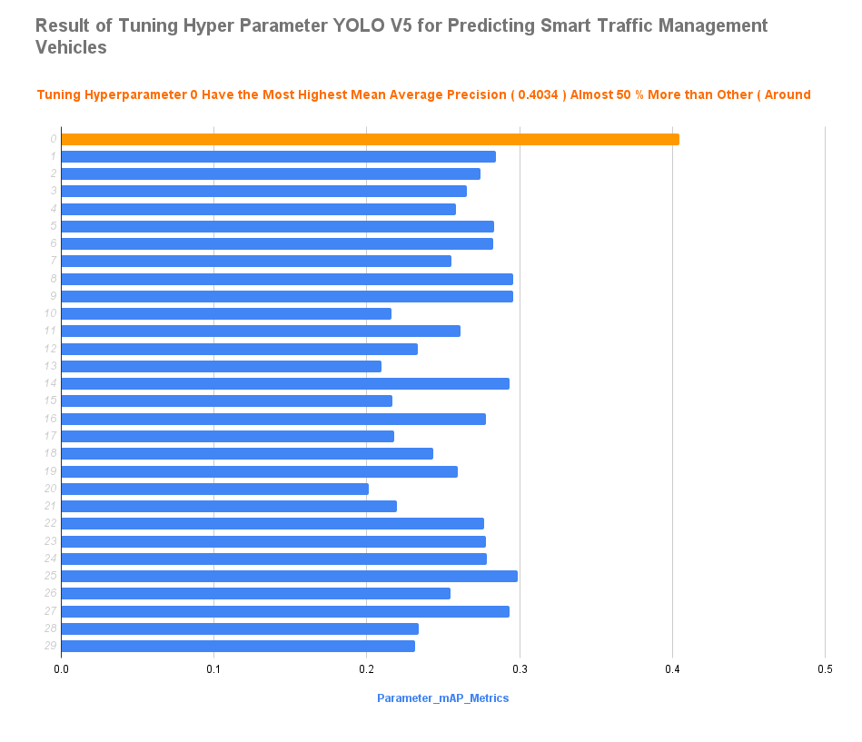
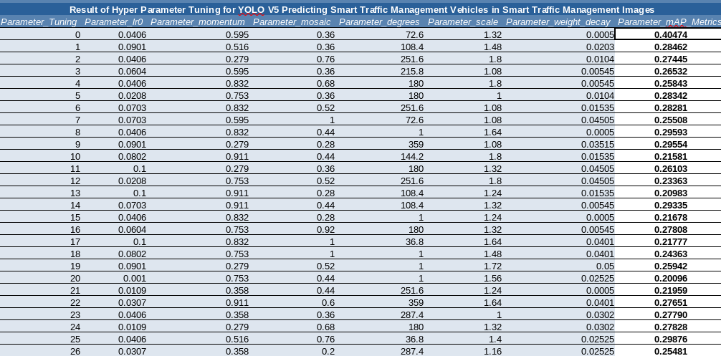
How Good is the Solutions ?
Best Tuning Hyperparameter are Tuning Hyperparameter Search 1 with Parameter Learning Rate 0 0.0052 , Parameter Momentum 0.595 , Parameter Mosaic 0.36 , Parameter Degrees 72 , Parameter Scale 1.32 , and Parameter Weight Decay 0.0005 with Mean Average Precision 0.4034 that is Almost 50 % more higher than other Tuning Hyperparameter YOLO V5 ( Around 0.2852 )

Slide 12
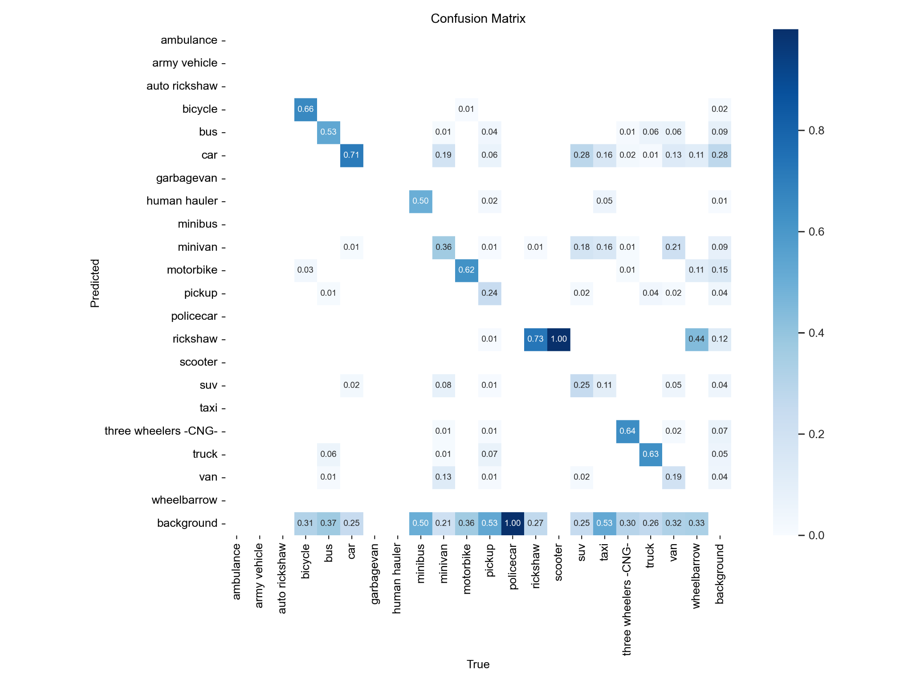
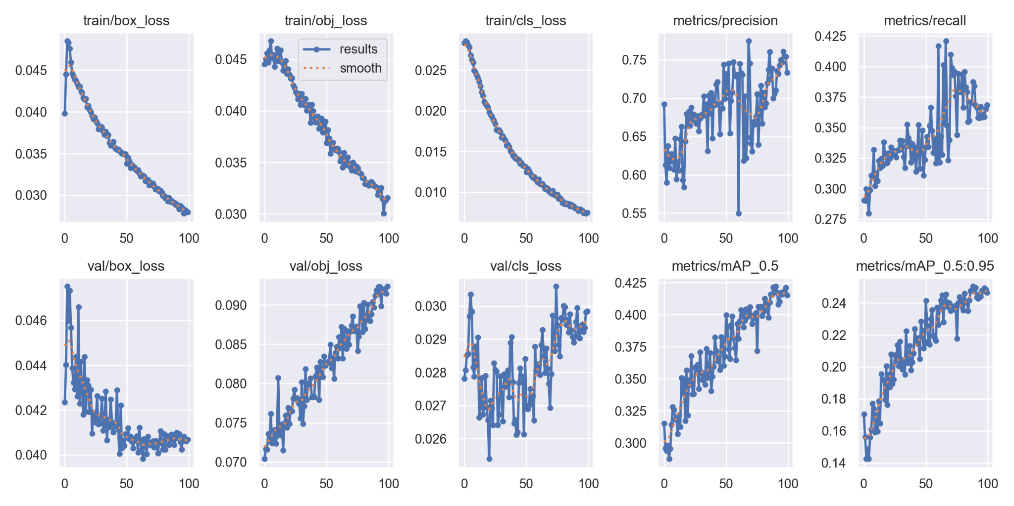
How Good is the Solutions ?
Traffic Management Vehicles Detection with Best Tuning Hyperparameter Have Mean Average Precision 0.78721 and Mean Average Precision Traffic Management Cars Detection 0.92351

Slide 13
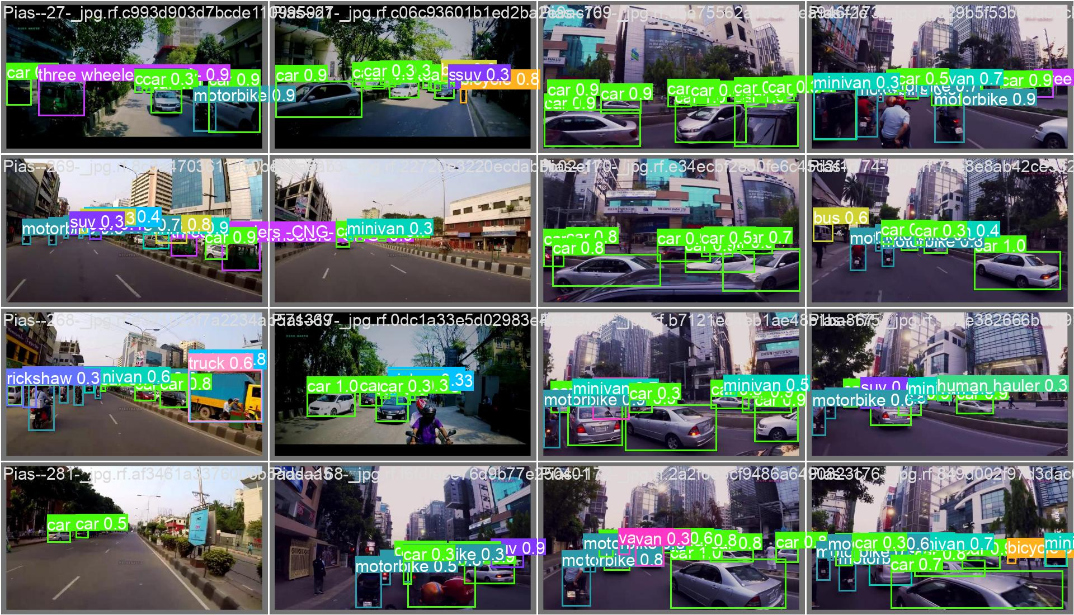
How Good is the Solutions ?
Traffic Management Vehicles Detection with Best Tuning Hyperparameter Have Mean Average Precision 0.78721 and Mean Average Precision Traffic Management Cars Detection 0.92351

Slide 14
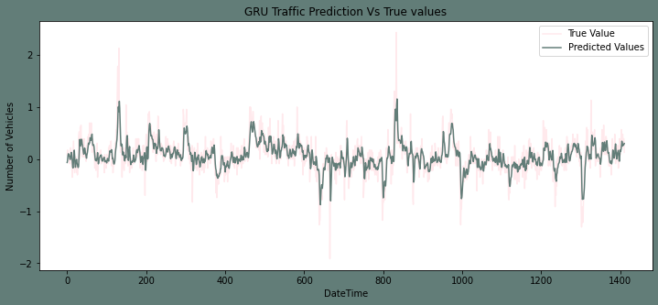
How Good is the Solutions ?
Traffic Management Vehicles Prediction using Recurrent Neural Network LSTM Predict Traffic Management Vehicles next 12 Hours with
Mean Square Error 4.521 and
Root Mean Square Error 2.2342

Slide 15
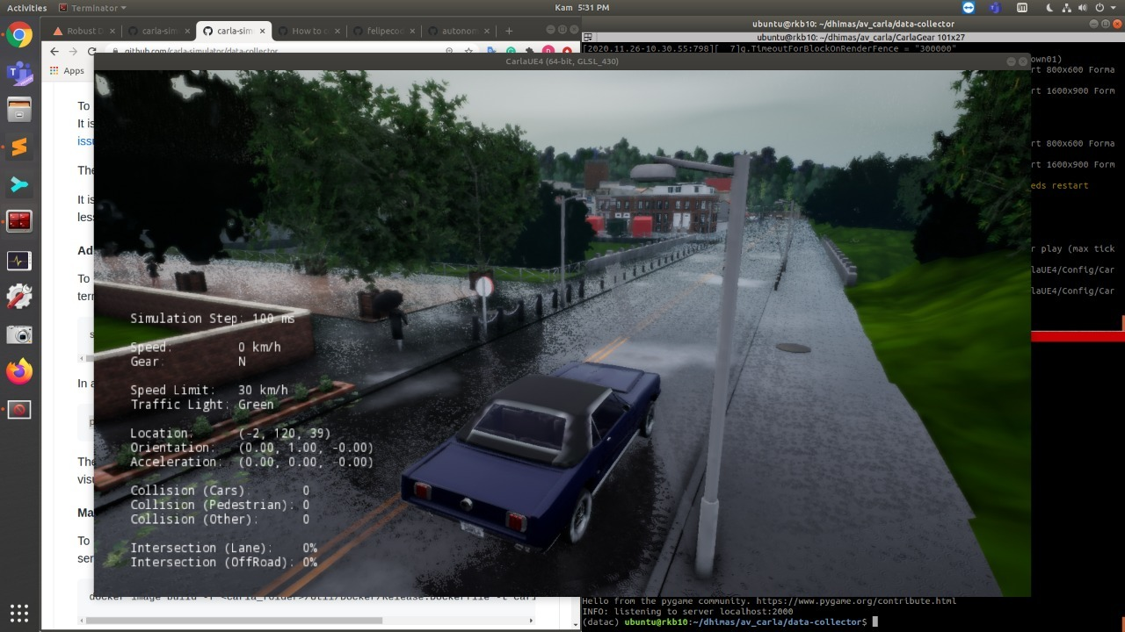
How Good is the Solutions ?
After Simulation of Smart Traffic Management System in Traffic Management System Simulation CARLA We got
Traffic Management Congestion Flow Rate with Traffic Management System ( 21 Vehicles / Minutes ) is 50 % Higher than Traffic Management Congestion Rate without Smart Traffic Management System ( Around 15 Vehicles / Minute ) and
Traffic Management Vehicles Pass Delay with Smart Traffic Management System ( 5 Seconds / Vehicles ) are 70 % Less Than Traffic Management Vehicles Pass Delay without Smart Traffic Management System ( Around 12 Seconds / Vehicles )

Slide 16
How Good is the Solutions ?
Based on Smart Traffics Management System Analysis We Can Have :
Traffic Management Vehicles Detection with Best Tuning Hyperparameter Have Mean Average Precision 0.78721 and Mean Average Precision Traffic Management Cars Detection 0.92351
Traffic Management Vehicles Prediction using Recurrent Neural Network LSTM Predict Traffic Management Vehicles next 12 Hours with Mean Square Error 4.521 and Root Mean Square Error 2.2342
After Simulation of Smart Traffic Management System in Traffic Management System Simulation CARLA We got Traffic Management Congestion Flow Rate with Traffic Management System ( 21 Vehicles / Minutes ) is 50 % Higher than Traffic Management Congestion Rate without Smart Traffic Management System ( Around 15 Vehicles / Minute ) and Traffic Management Vehicles Pass Delay with Smart Traffic Management System ( 5 Seconds / Vehicles ) are 70 % Less Than Traffic Management Vehicles Pass Delay without Smart Traffic Management System ( Around 12 Seconds / Vehicles )

Slide 17
Thank You for Your Time
Do You Have Any Questions ?

